Slide 1
Value streams
People, Process, Technology
Productivity factors
Vladimir POPOV

Slide 2
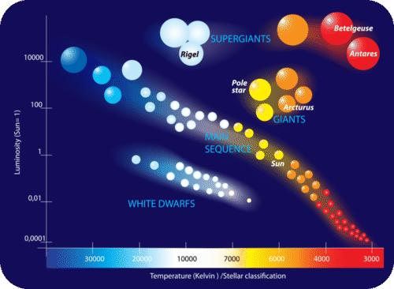
Comparing two teams
For this exercise let’s take two teams with difference in productivity.
Productivity defined as value delivered in a time interval.
We leave question of measuring productivity for later.
First, let’s see what factor of 2 in productivity means.

Slide 3

Twice VALUE
From value perspective double productivity means ability to deliver twice value in a given time interval

Slide 4
HALF TIME
From time perspective double productivity means ability to deliver equivalent value in half time interval

Slide 5

How to double productivity?
Productivity can be viewed from three angles.
Team productivity growing from individual members combined skill set and communication efficiency.
Individual productivity ranging from beginner to expert in each given skill.
Compound quality effect based on a simple fact that quality design and implementation have longer life cycle and, therefor, better return on investment.

Slide 6
Team scaling factors
3 = 3
Team productivity does not scale linearly with team size
Growing number of communication links adds complexity, noise
Number of links between N elements is (N*(N*1))/2
Team productivity will grow more like a SQRT(N)
Doubling productivity requires quadrupling the team with equal other factors.
12 = 66!

Slide 7
Team

Slide 8
Managers paradise
Communication overhead consumes all resources
Managers are hired to “take control”
Experts with skills removed from decision process and isolated
Hierarchy emerges with reports and orders circulating via “broken phone”, managers become messengers.
No one is personally responsible
36 = 630 !!!

Slide 9

Communication jam
200 people = ~20000 links

Slide 10

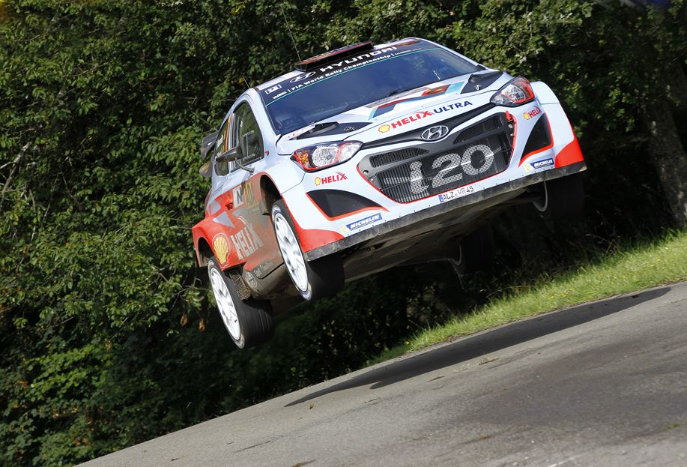
TOP Performers
XP tandem
L-R link, full focus
SCRUM star team polyvalent

Slide 11
INDIVIDUALS

Slide 12
Learning is the best investment
There is a different way of doubling productivity – LEARNING
Doubling individual productivity is an equivalent of quadrupling the team size
And doubling it over again is possible, while team size grow has limits
Professional
Competent
Experts
3 = 3

Slide 13
SUSTAINABLE DEBELOPMENT
Teaching and learning
Wisdom mixed with fresh ideas
Generations working together

Slide 14
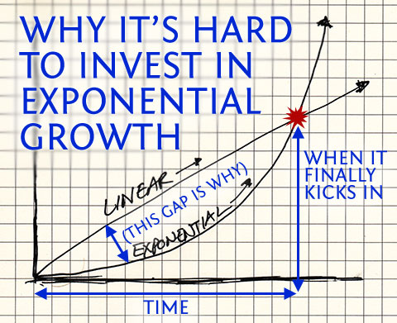
Doubling over and over
Doubling over time means exponential growth, an exponent has a “slow start”.
Exponential growth wins over time comparing with linear.
It is important to find exponential productivity growth factors.
Longer or shorter time intervals to implement one or another improvement will sculpture the strategy.

Slide 15
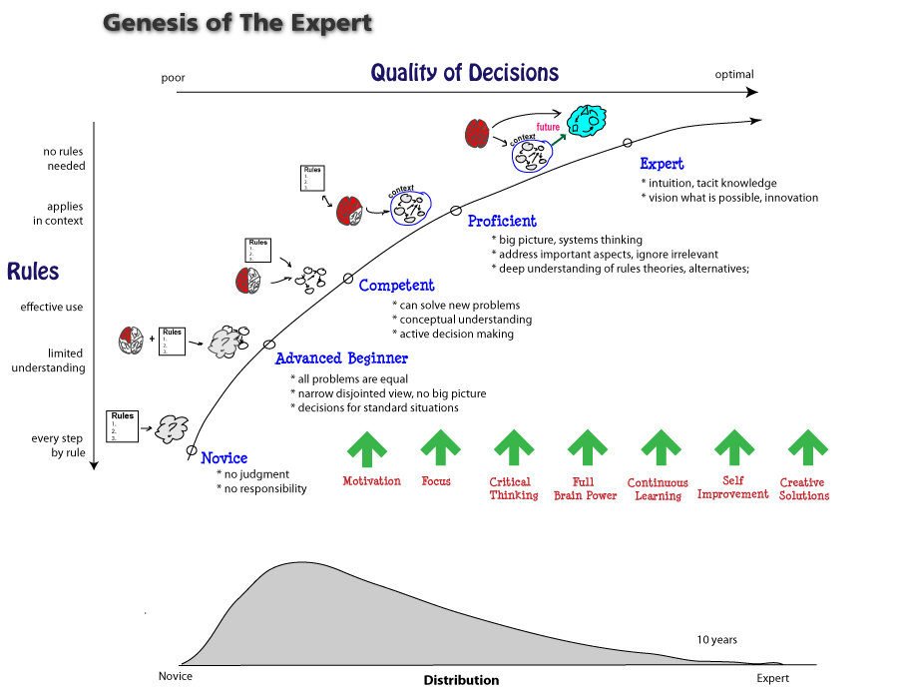
Dreyfus skill acquisition model
http://www.leanleadershipacademy.com/lla-and-the-genesis-of-the-lean-expert/

Slide 16
SKILL MASTERY
Level | Rules->Vision | Capability->Quality of Decision
Expert (10+ y) | No rules needed | Intuition, tacit knowledge Vision what is possible Innovation
Proficient (4+ y) | Applies in context | Big picture, system thinking Address important aspects, ignore irrelevant Deep understanding of rules theories, alternatives
Competent (1.5+ y) | Effective use | Can solve new problems Conceptual understanding Active decision making
Advanced Beginner | Limited understanding | All problems are equal Narrow disjoint view No big picture
Beginner | Every step by rule | No judgement No responsibility

Slide 17
Learning curve
Any Expert has a lot to learn
Any learning starts from Beginner

Slide 18

Team up for success

Slide 19
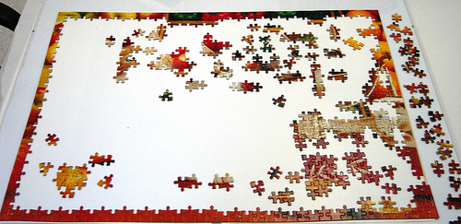
Assembling the puzzle
Our knowledge is a model of reality
The understanding is only as good and complete as the model is
More we learn, more we see what we don’t know yet, more we see the Big Picture

Slide 20

Continue learning
Call for help
Learn from experts
Share the knowledge

Slide 21
SEPARATION OF CONCERNS
A “rocket science” of keeping things “simple”.
“For every complex problem, there is a solution that is simple, neat, and wrong.”
Henry Louis Mencken. American humorous journalist and critic who influenced US fiction through the 1920s, 1880-1956
“Things should be made as simple as possible, but not any simpler. “
Albert Einstein. Physicist, Nobel Prize for Physics in 1921, 1879-1955.

Slide 22
MANIFESTO
Design with Perpetual Evolution in mind – We discover new opportunities.
Common Terminology and Design Patterns – We speak the same language.
Multi-dimensional Abstraction Model – We focus on what is important.
Multi-Platform – We unite force.
Fit for Automation – Humans think machines do.
CAD compliant – One picture worth a thousand words.

Slide 23
PRODUCTIVITY FACTORS
Team – an ecosystem shall have clear model and precise terminology. This facilitates and speeds up communication and designs. Use of common tools, like UML, mind mapping, planning will be even more efficient.
Individual – the adoption shall have reasonably low entry effort. Bootcamp tutorial with a lab which takes about three days. Learning shall be incremental, focused and continuous during and beyond tutorial.
Compound quality – platform shall introduce established communication model, resource allocation, activities life time and run time management, as well as inter “modules” communication protocol. Reuse shall be natural, extension simple and safe. In other words, a platform shall implements Open Architecture concept in practice.

